Slide 1

Digital Image Processing
Rajesh Kumar Tripathi
Assistant Professor
Dept. of Computer Engineering and Applications

Slide 2
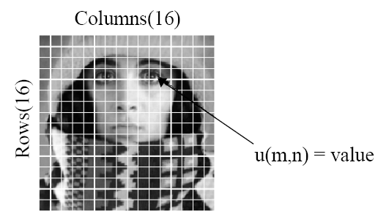
Basic Relationship between Pixels
An image is denoted by a function f(x,y).
Each element f(x,y) at location (x,y) is called a pixel.
There exist some basic but important relationships between pixels.
f(x, y)

Slide 3
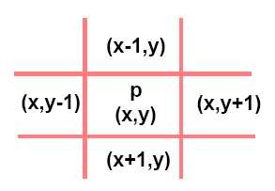
Basic Relationship between Pixels
A pixel p at location (x,y) has two horizontal and two vertical neighbors.
This set of four pixels is called 4-neighbors of p=N₄(p).
Each of these neighbors is at a unit distance from p.
If p is a boundary pixel then it will have less number of neighbors.

Slide 4
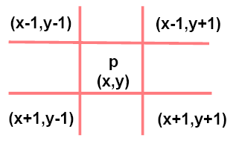
Basic Relationship between Pixels
A pixel p has four diagonal neighbors=N_{D}(p)
The points of N₄(p) and N_{D}(p) together are called 8-neighbors of p.
N₈(p) = N₄(p) U N_{D}(p)
If p is a boundary pixel then both N_{D}(p) and and N₈(p) will have less number of pixels.

Slide 5
Basic Relationship between Pixels
Two pixels are said to be connected if they are adjacent in some sense
They are neighbors(N₄,N_{D} or N₈) and
Their intensity values (gray levels) are similar
For a binary image B, two points p and q will be connected if q Є N(p) or p Є N(q) and B(p) = B(q).

Slide 6
Basic Relationship between Pixels
Neighborhood
Adjacency
Connectivity
Paths
Regions and boundaries
(X-1,Y-1) | (X-1,Y) | (X-1,Y+1)
(X,Y-1) | (X,Y) | (X,Y+1)
(X+1,Y-1) | (X+1,Y) | (X+1,Y+1)

Slide 7
Adjacency
Let V be the set of intensity values
4-adjacency: Two pixels p and q with values from V are 4-adjacent if q is in the set N₄(p).
8-adjacency: Two pixels p and q with values from V are 8-adjacent if q is in the set N₈(p).
m-adjacency: Two pixels p and q with values from V are m-adjacent if
(i) q is in the set N₄(p), or
(ii) q is in the set N_{D}(p) and the set N₄(p) ∩ N₄(q) is
empty (has no pixels whose values are from V).
Notes:
Mixed adjacency is a modification of 8-adjacencyand is used to eliminate the multiple path connections that often arise when 8-adjacency is used.

Slide 8
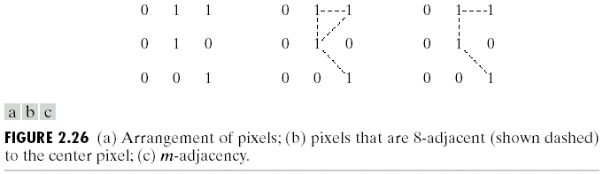
Examples: Adjacency and Path
Find 8-adjacency & m-adjacency of the pixel in the centre.
Note: V = {1}

Slide 9
Examples: Adjacency and Path
V = {1}
Fig (b) shows the ambiguity in 8-adjacency

Slide 10
Path
A (digital) path (or curve) from pixel p with coordinates (x₀, y₀) to pixel q with coordinates (x_{n}, y_{n}) is a sequence of distinct pixels with coordinates
(x₀, y₀), (x₁, y₁), …, (x_{n}, y_{n})
Where (x_{i}, y_{i}) and (x_{i-1}, y_{i-1}) are adjacent for 1 ≤ i ≤ n.
Here n is the length of the path.
If (x₀, y₀) = (x_{n}, y_{n}), the path is closed path.
We can define 4-, 8-, and m-paths based on the type of adjacency used.

Slide 11
Connectivity
Connected in S
Let S represent a subset of pixels in an image. Two pixels p with coordinates (x₀, y₀) and q with coordinates (x_{n}, y_{n}) are said to be connected in S if there exists a path
(x₀, y₀), (x₁, y₁), …, (x_{n}, y_{n})

Slide 12
Region, Boundary and Edge
Region
We call R a region of the image if R is a connected set
Boundary
The boundary of a region R is the set of pixels in the region that have one or more neighbors that are not in R
Edge
Pixels with derivative values that exceed a preset threshold

Slide 13
Distance Measures
Given pixels p, q and z with coordinates (x, y), (s, t),
(u, v) respectively, the distance function D has following
properties:
D(p, q) ≥ 0 [D(p, q) = 0, iff p = q]
D(p, q) = D(q, p)
D(p, z) ≤ D(p, q) + D(q, z)

Slide 14
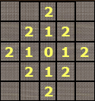
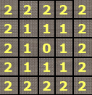
Distance Measures …
The following are the different Distance measures:
Euclidean Distance :
D_{e}(p, q) = [(x-s)² + (y-t)²]^{1/2}
City Block Distance:
D₄(p, q) = |x-s| + |y-t|
Chess Board Distance:
D₈(p, q) = max(|x-s|, |y-t|)
City Block Distance
Chess Board Distance
Notes:
The name City block distance (also referred to as Manhattan distance) is explained if you consider two points in the xy-plane. The shortest distance between the two points is along the hypotenuse, which is the Euclidean distance.
It is also known as chessboard distance, since in the game ofchess the minimum number of moves needed by a king to go from one square on a chessboard

Slide 15
Problems
When you enter a dark theater on a bright day, it takes an appreciable interval of time before you can see well enough to find an empty seat. Which of the visual process is at play in this situation?
Consider the two image subsets, S1 and S2, shown in the following figure. For V={1}, determine whether these two subsets are a) 4-adjacent, b) 8-adjacent, or c) m-adjacent.
S1 |  |  |  |  | S2
0 | 0 | 0 | 0 | 0 | 0 | 0 | 1 | 1 | 0
1 | 0 | 0 | 1 | 0 | 0 | 1 | 0 | 0 | 1
1 | 0 | 0 | 1 | 0 | 1 | 1 | 0 | 0 | 0
0 | 0 | 1 | 1 | 1 | 0 | 0 | 0 | 0 | 0
0 | 0 | 1 | 1 | 1 | 0 | 0 | 1 | 1 | 1

Slide 16
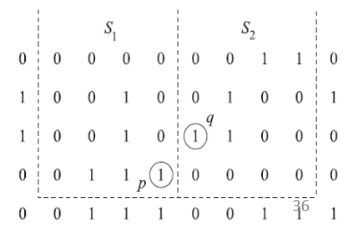
Problems
S1 and S2 are not 4-connected because q is not in the set N4(p);
S1 and S2 are 8-connected because q is in the set N8(p);
S1 and S2 are m-connected because (i) q is in ND(p), and (ii)the set N4(p) ∩ N4(q) is empty.
S1 |  |  |  |  | S2
0 | 0 | 0 | 0 | 0 | 0 | 0 | 1 | 1 | 0
1 | 0 | 0 | 1 | 0 | 0 | 1 | 0 | 0 | 1
1 | 0 | 0 | 1 | 0 | 1 | 1 | 0 | 0 | 0
0 | 0 | 1 | 1 | 1 | 0 | 0 | 0 | 0 | 0
0 | 0 | 1 | 1 | 1 | 0 | 0 | 1 | 1 | 1

Slide 17
Problems …
3. Consider the image segment shown
a) Let V={0,1} and compute the length of the shortest 4-,8-, and m-path between p and q. if a particular path does not exist between these two points, explain why.
b) Repeat for V={1,2}
 | 3 | 1 | 2 | 1 | (q)
 | 2 | 2 | 0 | 2
 | 1 | 2 | 1 | 1
(p) | 1 | 0 | 1 | 2

Slide 18
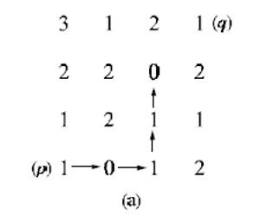
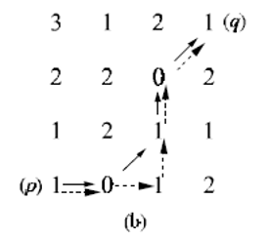
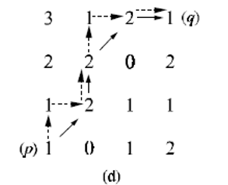
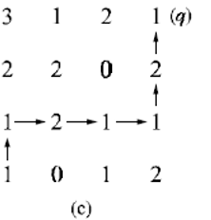
Problems …
 | 3 | 1 | 2 | 1 | (q)
 | 2 | 2 | 0 | 2
 | 1 | 2 | 1 | 1
(p) | 1 | 0 | 1 | 2
3. Consider the image segment shown
a) When V = {0,1}, 4-path does not exist between p and q because it is impossible to get from p to q by traveling along points that are both 4-adjacent and also have values from V .
b) Repeat for V={1,2}

